Slide 1


UE19CS204 – Web Technologies Mini Project
Project Title - Souvenir Online Shop
Section - E
Name | SRN
Mohith R | PES1UG19CS277
P J Subrahmanya Hande | PES1UG19CS316
Nandana K A | PES1UG19CS290
GITHUB Link - https://github.com/MohithR17/Web-Tech-project.git

Slide 2
Abstract
The Souvenir is an important component of the tourist experience, with most tourists bringing back mementos and souvenirs as evidence.
People like to be reminded of special moments in their lives and to hold evidence of those special moments.
A Souvenir truly represent culture, history and lifestyle of the place/region/country.
Here we have made an attempt to provide a platform/portal to buy souvenirs from selected places from India.

Slide 3
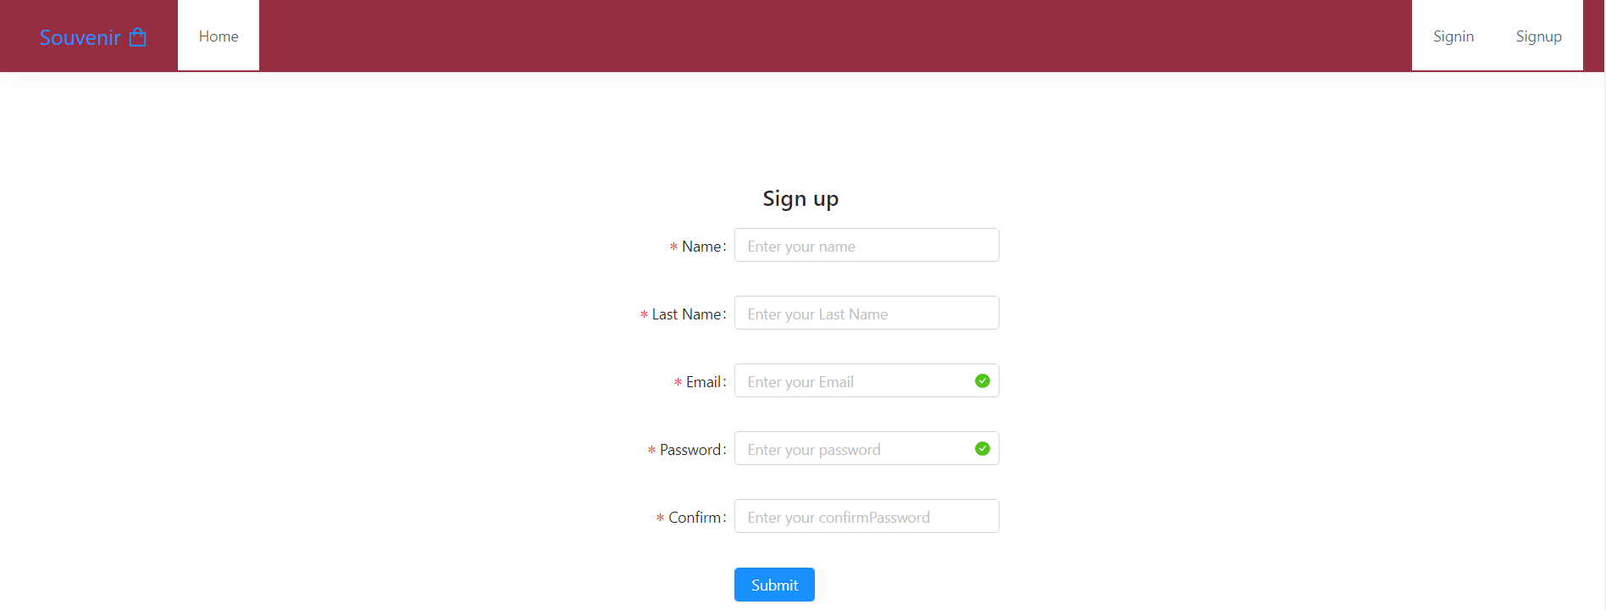
Sign Up page

Slide 4
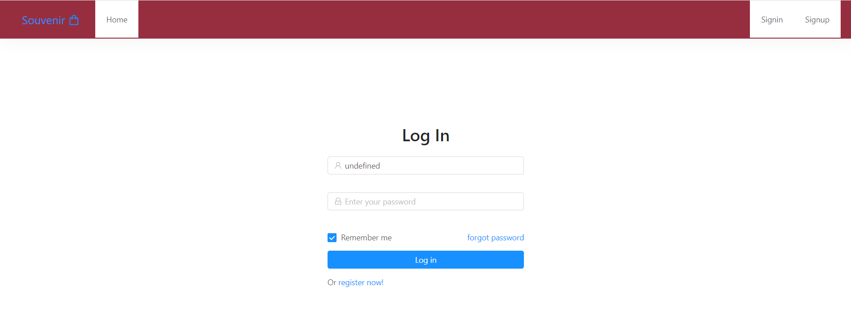
Log In

Slide 5
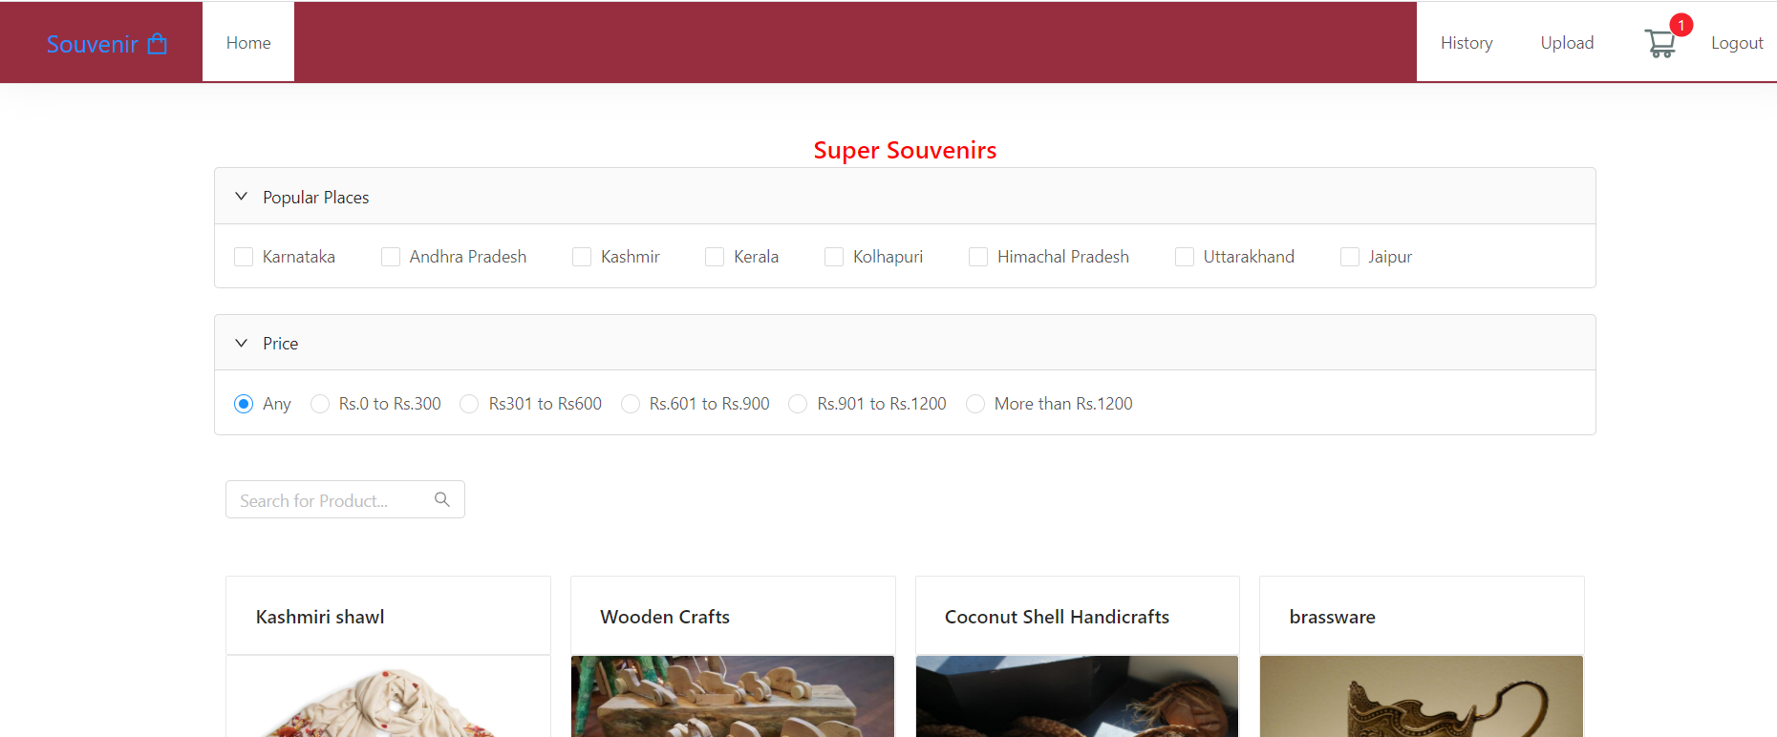
Home Page(Landing page)

Slide 6
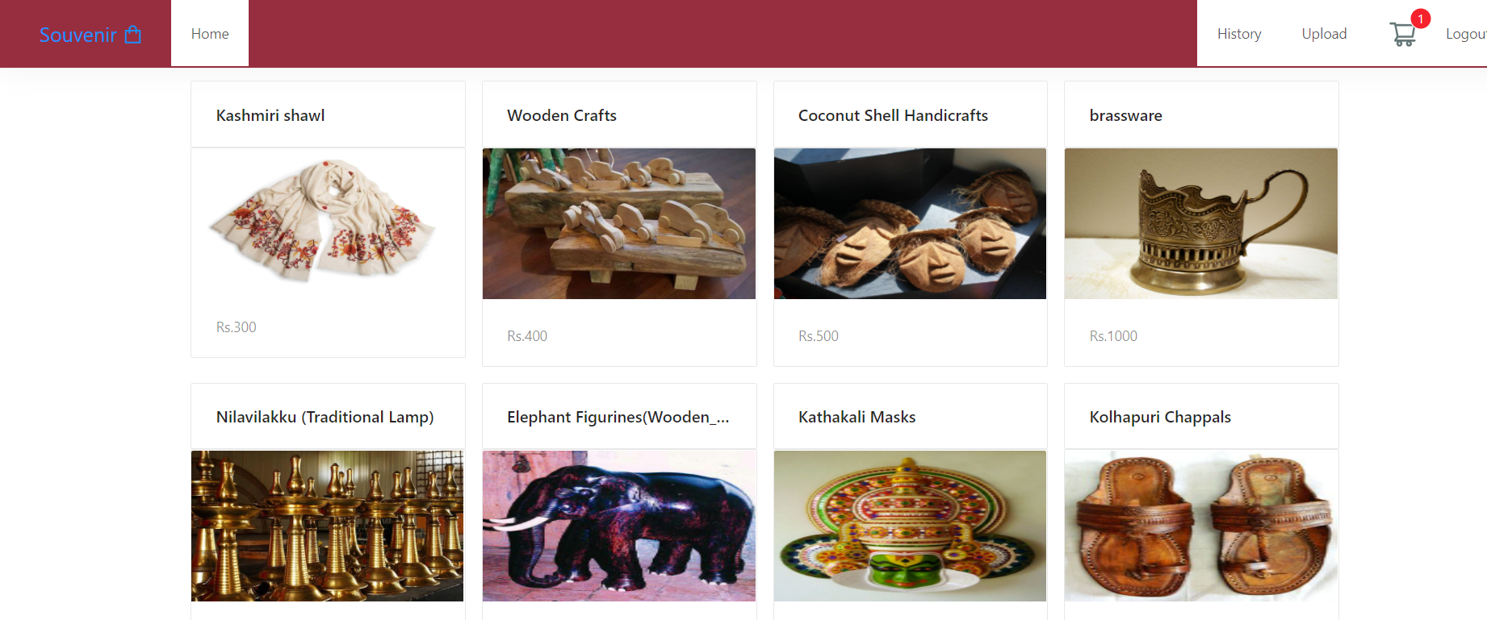
Home page when scrolled down

Slide 7
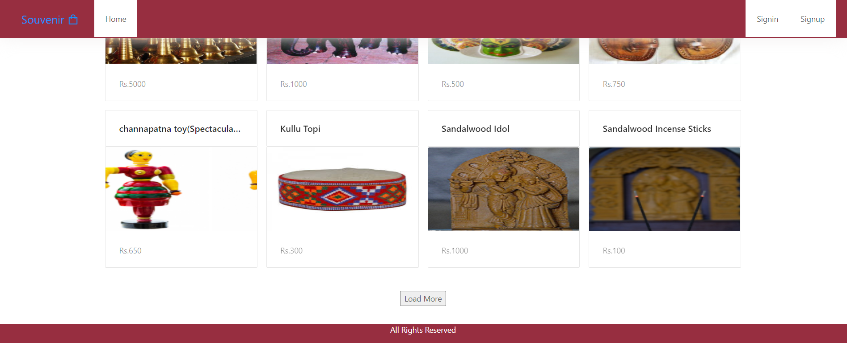
Home page when scrolled further down

Slide 8
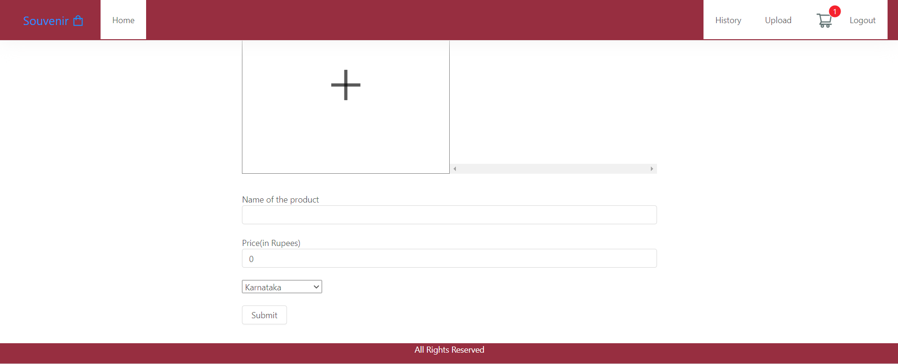
UploadProduct page when user clicks on upload on home page, user is navigated to this page

Slide 9
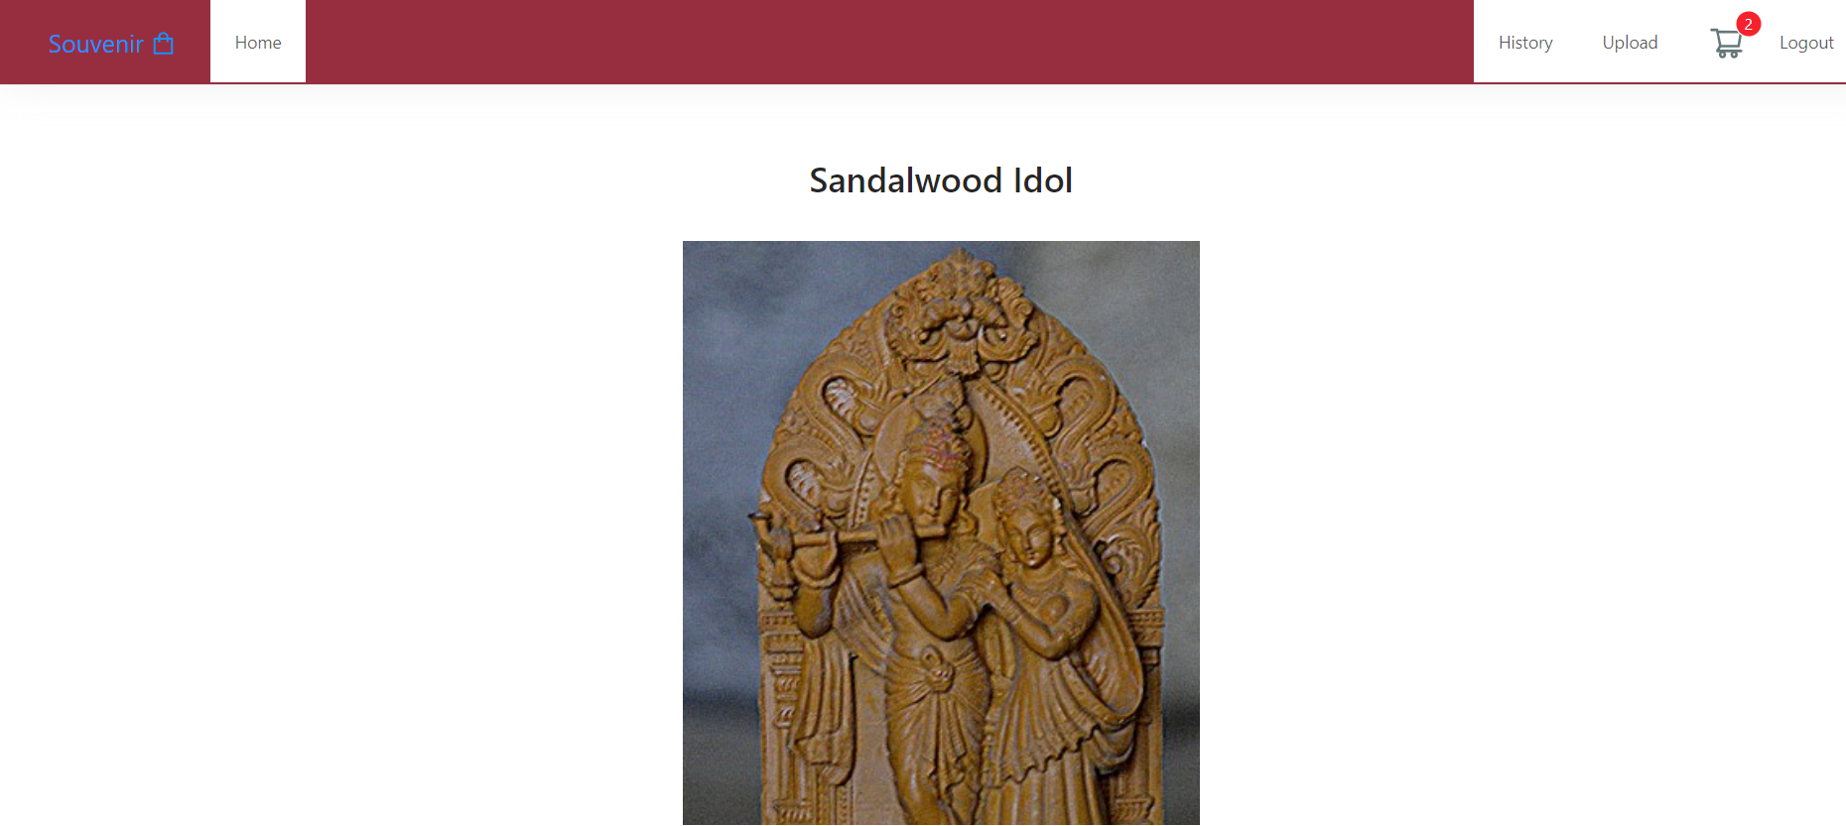
DetailProductPage.js when user clicks on the image of the product on landing page, user is navigated to this page

Slide 10
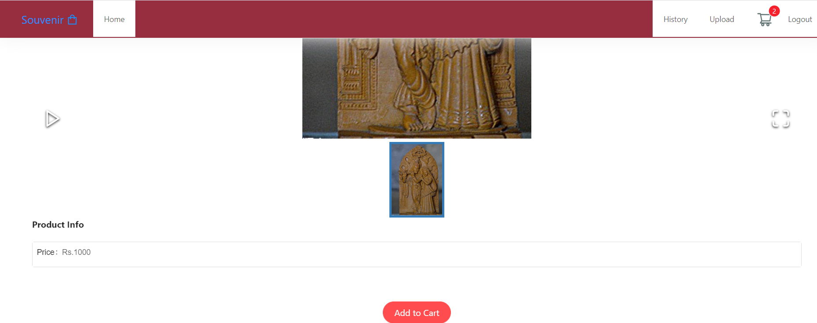
UploadProduct page when scrolled down

Slide 11
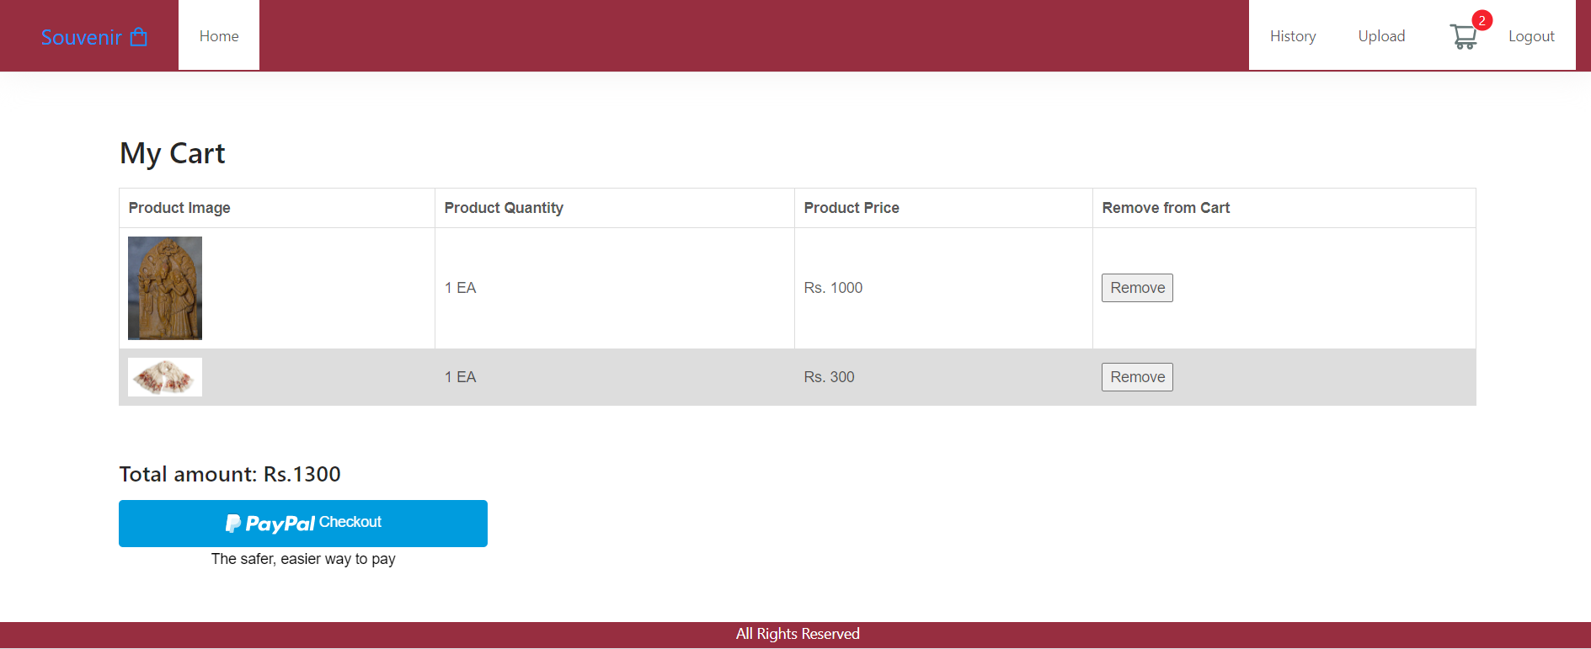
My cart Navigated from UploadProduct page when user wishes to add product to cart

Slide 12
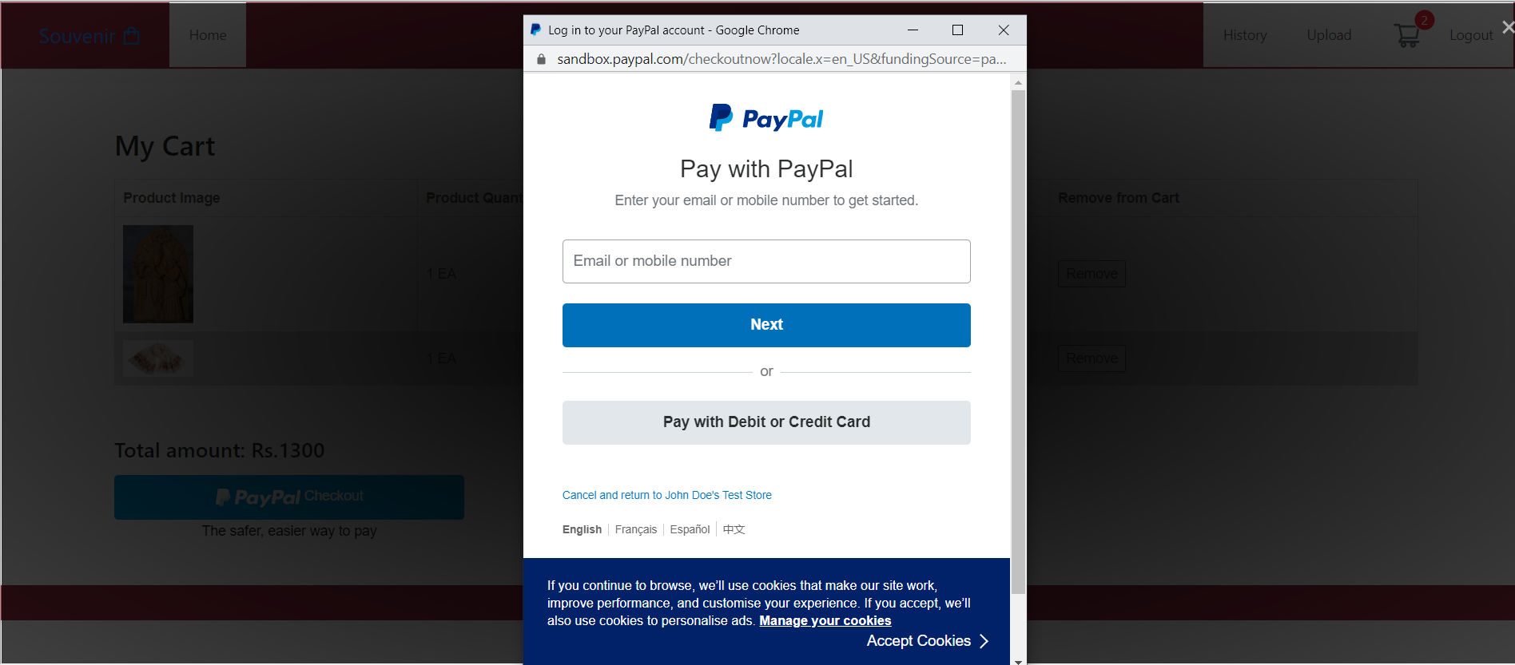
Paypal payment from My cart

Slide 13
Technologies Used
We have used HTML, CSS, JavaScript in the front end along with React JS, backend Database is Mongo DB. Node Js with Express JS act as a controller which control and mediate between database and front end
Modules:
antd – for styling
axios –HTTP client for the browser and node.js
Router from express.Router() – route in the server end
multer – This is a node.js middleware for handling multipart/form-data.
Dropzone from ‘react-dropzone’ for uploading images of the products in FileUpload.js file of our project
React-router-DOM – DOM bindings for React Router
ImageGallery from ‘react-image-gallery’ – in ProductImage section of DetailProductPage where user can view the image and if multiple images are present user can scroll the images

Slide 14
Nodemon
nodemon is a tool that helps develop node.js based applications by automatically restarting the node application when file changes in the directory are detected.
Mongoose
elegant mongodb object modeling for node.js
Many other modules as specified in the package.json in the root and client Directory

Slide 15
Member Contributions
Mohith R(PES1UG19CS277):
Landing page – which is the home page where user can view the products, search products based on place, price and search by typing product title and from here user is navigated to signup, login, upload products and history page
Uploading the product :
Upload product page allows user to upload details of product, uploading image is handled in utils/fileupload component in this I have used Dropzone from ‘react-dropzone’ which allows us to drop images from our system to the app
Axios post request is made and in route/product.js using multer module the images are uploaded into a folder called uploads
From route/product.js we get a response which is an object with success, image and filename property. Success specifies if the upload is successful or not, images are the path with filename which we store in image state of Upload product page and fileupload, Upload product page is parent of fileupload so we pass refreshFunction as props for fileupload to update state of Upload product page
In fileupload component image is uploaded and rest of the details are taken in Upload product page on submitting all the details post request is sent to upload whole product into mongo db
In models/products.js productSchema is created which is the product collection in mongodb we save it to mongodb by creating the product instance and passing the request body(which has the details of Product) which we get when the request is made from Upload product page

Slide 16
Landing Page : This the main page which links all other pages and has most of the functionalities involved
The products are displayed in Card tag along with the images and prices.
This page has children component defined in sections Folder which is under LandingPage folder and LandingPage.js which has LandingPage component is also in LandingPage folder .
Child components of Landing page:
Checkbox is used for displaying only the Products whose Sovenir Places are ticked, CheckBox, Collapse and panel tags are used(from antd)
Radiobox is used for displaying only those Products whose price matches the limit specified by the radio which is selected by the user, Radio, CheckBox, Collapse and panel tags are used(from antd)
Data.js contains data related to prices and Sovenir Places
SearchFeature component searches for the products whose title is typed by the user, Search tag is used (antd)
To make all these functionality work, events which call the callback functions are taken care and getProducts function takecare of fetching the data from mongodb by request which has information of all the filters and gets Products as response
First we load 12 Products and there is a button called Loadmore when that is clicked the next 4 products are also shown(Loads more data).
ProductDetail Page: The user is navigated to this page when he clicks on the image slider of the product on Landing page, in this page user can view the image of the product, price and he could add the product to the cart
Except the login, signin , Paypal , add to cart and history all other functionality which is not described above including setting up mongodb, filling the form and this presentation preparation and many more are done by Mohith R

Slide 17
P J Subrahmanya Hande(PES1UG19CS316):
Functionality involving user, signin, login and Paypal
Nandana K A(PES1UG19CS290):
Functionality involving cartpage and history

Slide 18
Thank you

